Slide 1
ARA - Using and Developing Open Source Tools in the Irish Film Institute
Kieran O’Leary - Irish Film Institute
Dublin - 2019-03-21
@kieranjol

Slide 2
Topics
Initial explorations into Open Source formats
Using/Creating Open Source Tools in the Irish Film Institute
The Four Freedoms of Open Source Software
IFIscripts
How to contribute!

Slide 3
Four Freedoms of Free Software
A program is free software if the program's users have the four essential freedoms: [1]
The freedom to run the program as you wish, for any purpose (freedom 0).
The freedom to study how the program works, and change it so it does your computing as you wish (freedom 1). Access to the source code is a precondition for this.
The freedom to redistribute copies so you can help others (freedom 2).
The freedom to distribute copies of your modified versions to others (freedom 3). By doing this you can give the whole community a chance to benefit from your changes. Access to the source code is a precondition for this.
https://www.gnu.org/philosophy/free-sw.en.html

Slide 4
IFI Irish Film Archive
Professional and amateur film and video
Library
Paper and artefact collections
Born digital cinema and broadcast deposits
25% Funding from Irish Arts Council
Other funding generated through partners such as The Irish Film Board, Broadcasting Authority of Ireland, The Arts Council

Slide 5
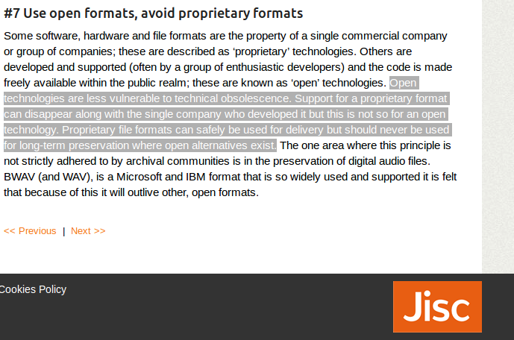
Why open formats?
https://web.archive.org/web/20160721092004/http:/jiscdigitalmedia.ac.uk/infokit/audiovisual-digitisation/seven-principles-of-digitisation

Slide 6
Why FFV1?
Free/Open
Partially self-descriptive (doesn’t fully rely on container for context)
Actively standardised by IETF via CELLAR
Mediaconch conformance checker via PREFORMA
Embedded checksums per frame/slice
Helpful archive/FFmpeg community
Potential to sponsor developments
Lossless compression

Slide 7
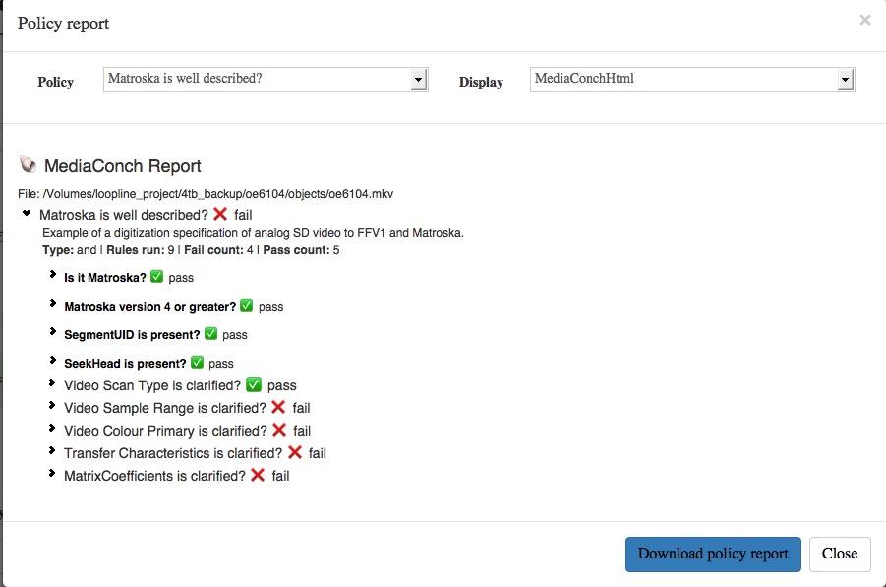
Mediaconch failure

Slide 8
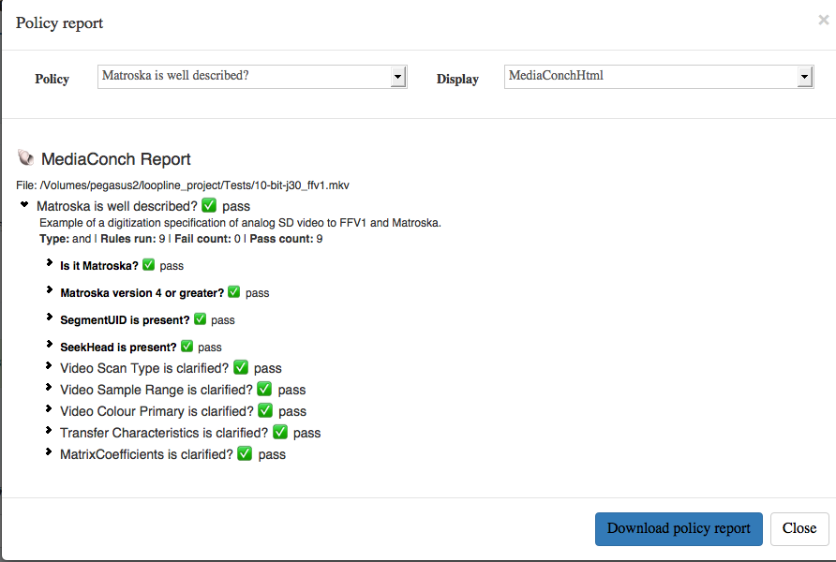
Mediaconch PASS!!11!!!!

Slide 9
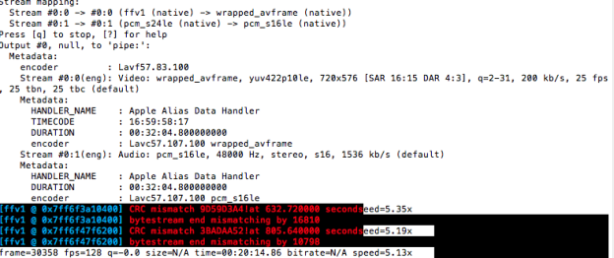

Slide 10
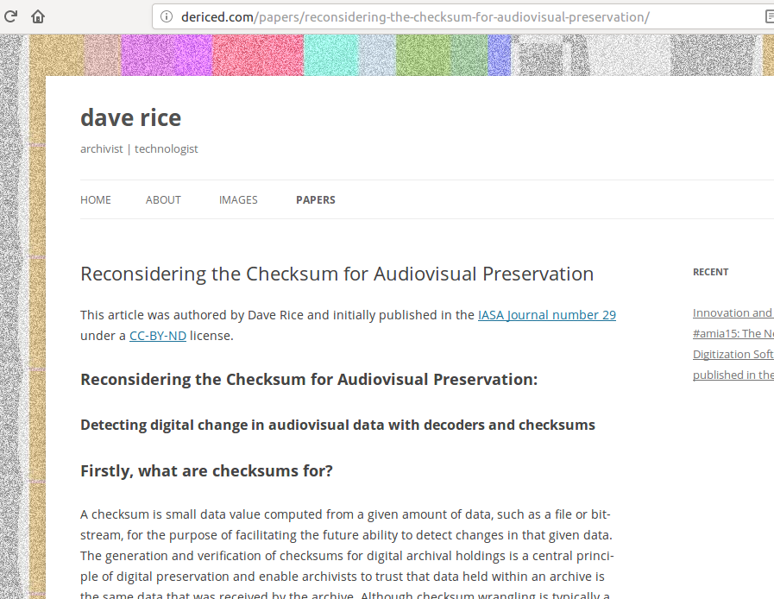
http://dericed.com/papers/reconsidering-the-checksum-for-audiovisual-preservation/

Slide 11
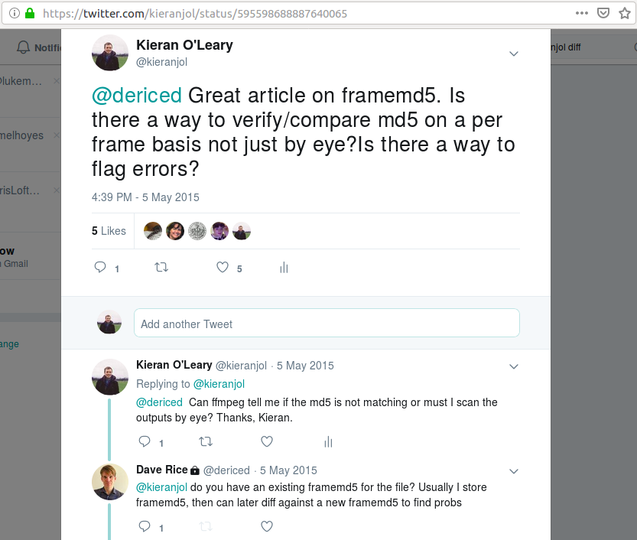

Slide 12
https://github.com/mediamicroservices/mm/blob/master/makelossless#L95

Slide 13
Four Freedoms of Free Software
A program is free software if the program's users have the four essential freedoms: [1]
The freedom to run the program as you wish, for any purpose (freedom 0).
The freedom to study how the program works, and change it so it does your computing as you wish (freedom 1). Access to the source code is a precondition for this.
The freedom to redistribute copies so you can help others (freedom 2).
The freedom to distribute copies of your modified versions to others (freedom 3). By doing this you can give the whole community a chance to benefit from your changes. Access to the source code is a precondition for this.
https://www.gnu.org/philosophy/free-sw.en.html

Slide 14
FFV1/MKV workflow
Python script (normalise.py) that will:
Transcode V210/MOV to FFV1/MKV via ffmpeg
Frame-level checksums are produced for the source V210/MOV
Frame-level checksums are produced from the FFV1 file
Losslessness check is automated by comparing source and destination checksums.
Technical metadata (mediainfo/mediatrace) extracted via mediainfo
Conformance check via mediaconch
Logs/Objects/Metadata folder structure
Checksum manifest is generated.
H264/MOV access copy is generated
Quality Controlled
Accessioned
Technical Cataloguing
Preservation Storage
Periodical retrieval for fixity checks

Slide 15
Terminal report

Slide 16
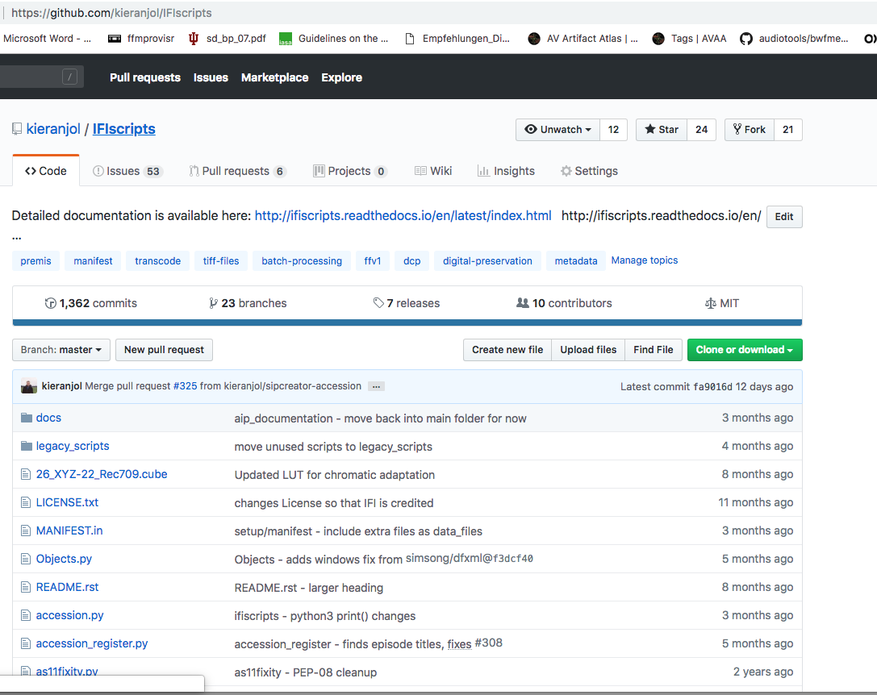

Slide 17
List of tasks for migrating a videotape collection to files
Audit the collection to determine quantity and formats
Research and devise workflows for each format type
Select the items that will be the focus of preservation
Migrate tape materials to file
Quality Control
Arrange the digital items into consistent packages
Make accessible copies
Describe/catalogue the content
Store fixity/integrity information
Rights
Make 3 copies of every file
Store metadata about the objects
Make the material accessible
Adhere to ongoing collections management procedures

Slide 18
What IFIscripts does
Transfer files with automated integrity/fixity checks
Normalise files and verify the integrity of the process
Generate Access/Watermarked/Mezzanine copies
Generate Archival Information Packages
Automate technical cataloguing using PBCore
Perform validation on various formats
Generate and validate checksum manifests
Generate detailed logs using PREMIS terminology
Automate aspects of registration/Object Entry/Accessioning
Many more bespoke tools..

Slide 19
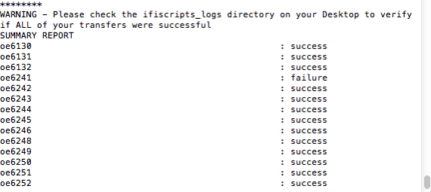

Slide 21
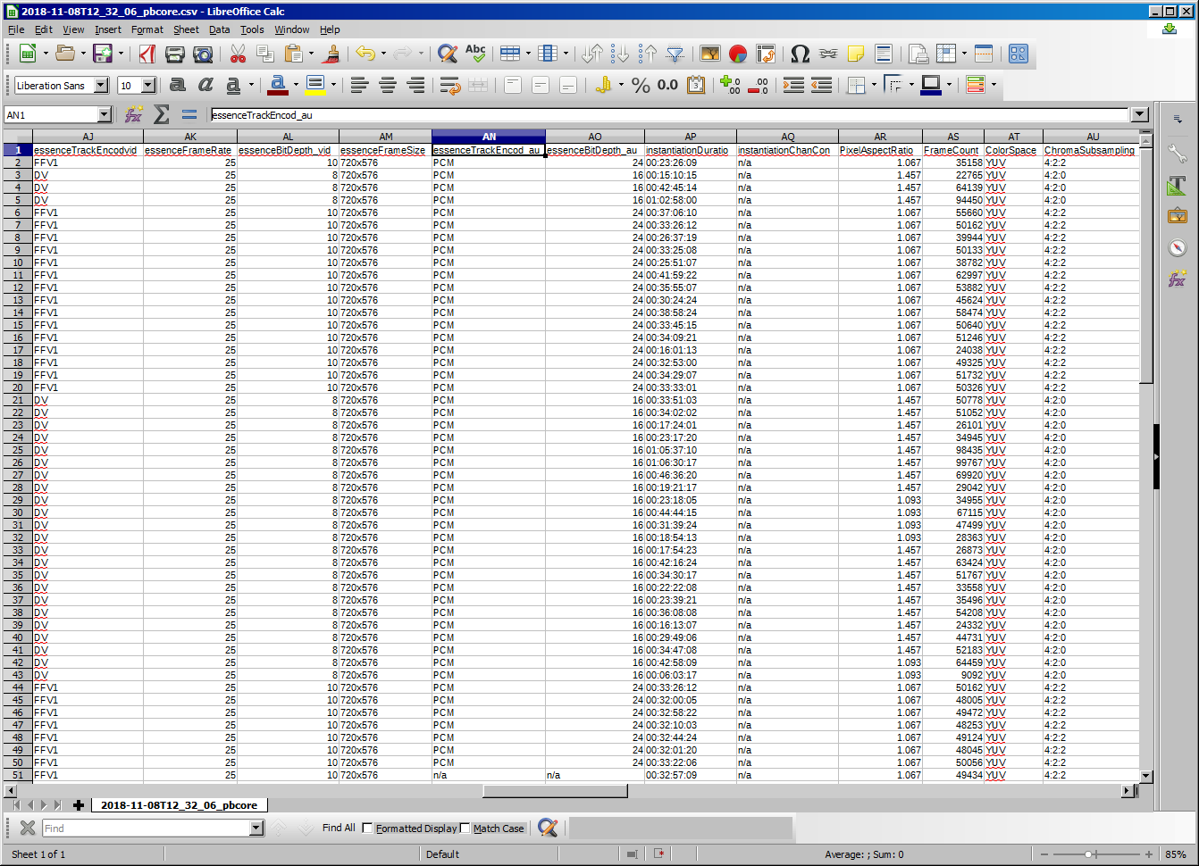

Slide 22
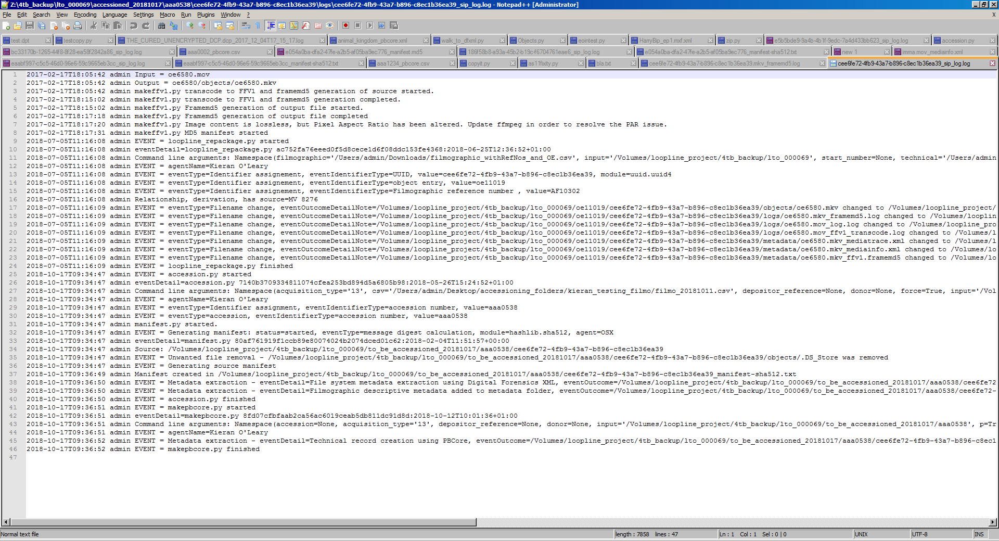

Slide 23
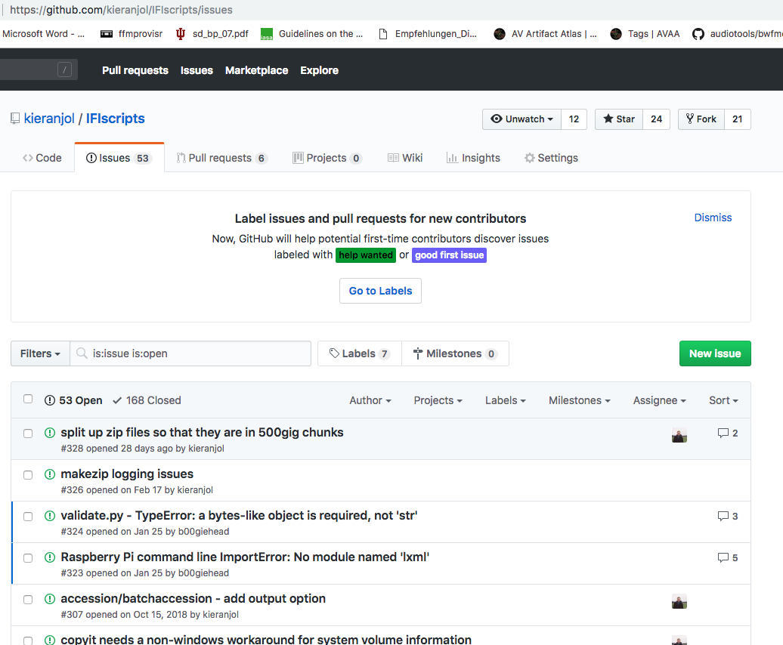

Slide 24
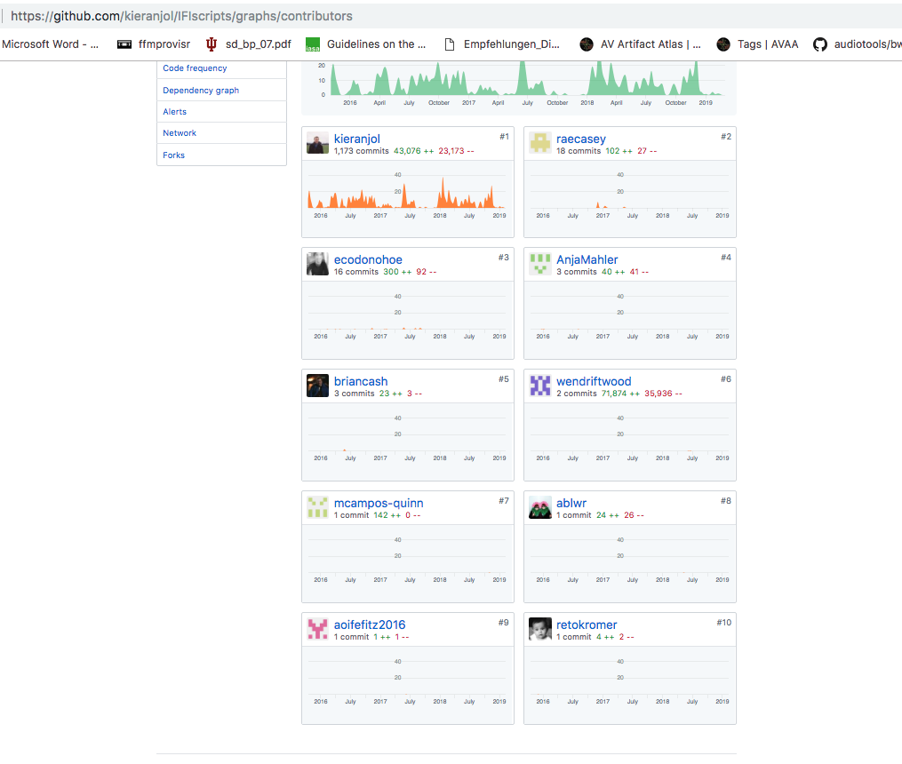

Slide 25
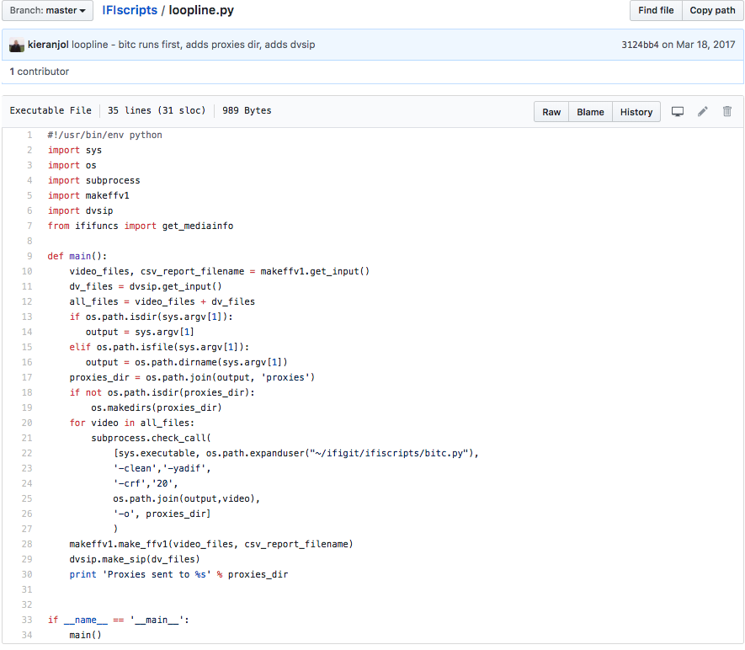

Slide 26
Open Source Tools
FFmpeg - normalisation, QC, fixity, accessibility
QCTools - Quality Control
rsync/cp/gcp - file transfer and backups
Mediainfo - Technical metadata and QC
Mkvpropedit - Matroska editing and chapter insertion
Mediaconch - validation/QC
Python - Programming language for workflows
IFIscripts - Ingest/technical metadata/fixity/AIP generation and more!
GNU - Various tools for auditing - grep, tree, ls, find, gcc
Ubuntu - Useful for processing drives
LibreOffice - Better at handling CSV than Excel
DVAnalyser - DV-specific QC
BWF Metaedit - adding bext chunk and metadata
VLC - Quality Control/Cataloguing
Vrecord - Used by vendor for tape capture to FFV1/Matroska
Digital Forensics XML - preserve file system metadata
Rawcooked - reversibly normalise film scans

Slide 27
Standards
Collections management (OAIS, Spectrum)
Metadata (PREMIS, PBCore)
Vocabularies (Library of Congress Subject Headings, Genre/Form)
Open File formats via CELLAR (FFV1/Matroska (mkv))

Slide 28
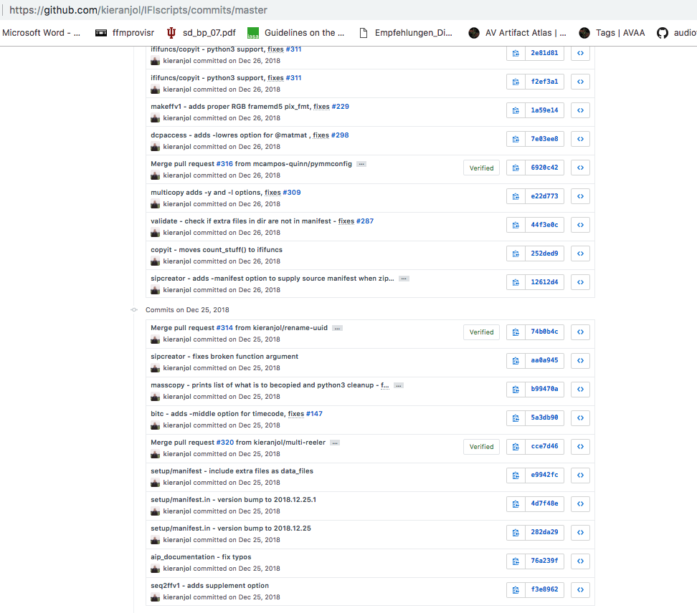

Slide 29
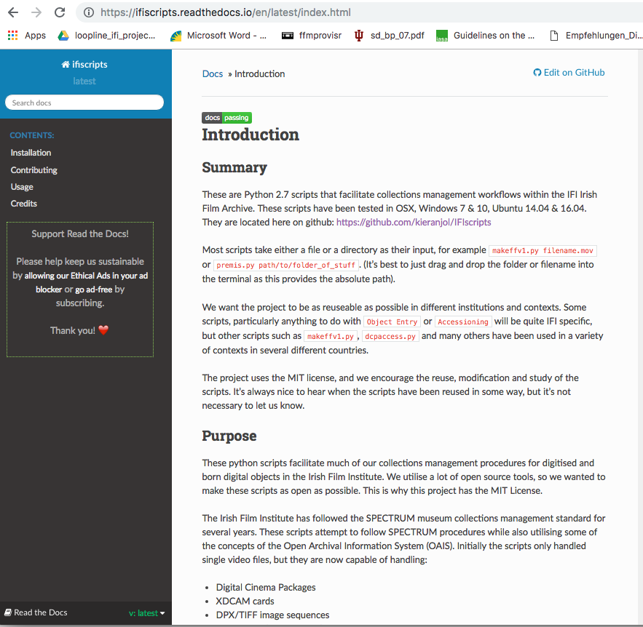

Slide 30
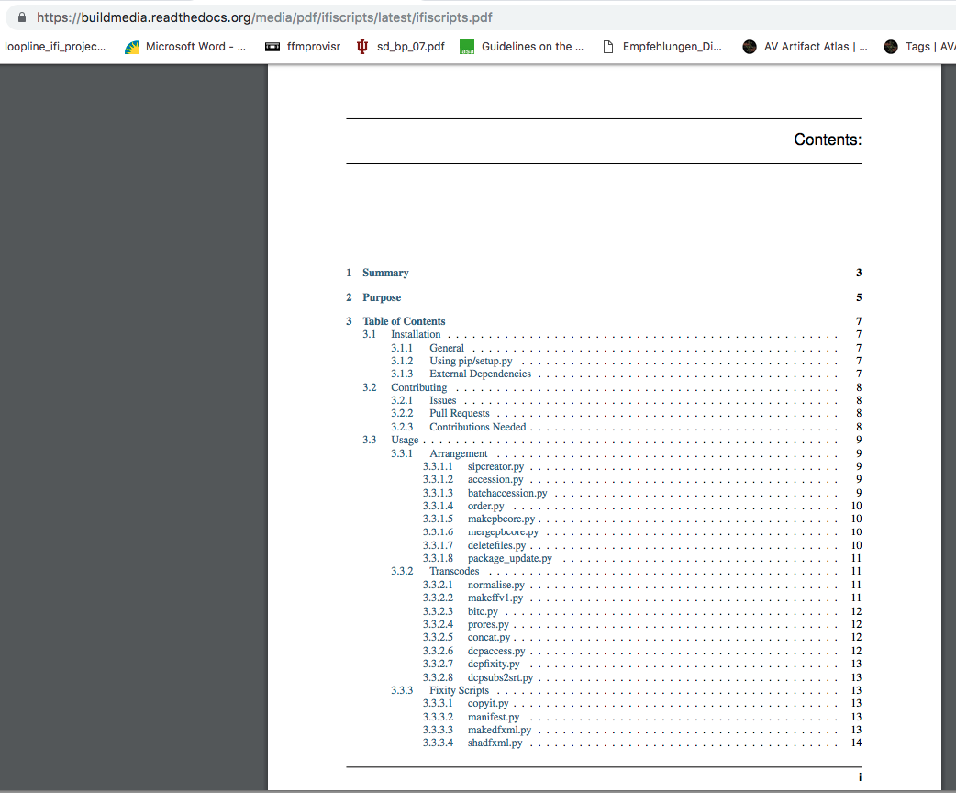

Slide 31
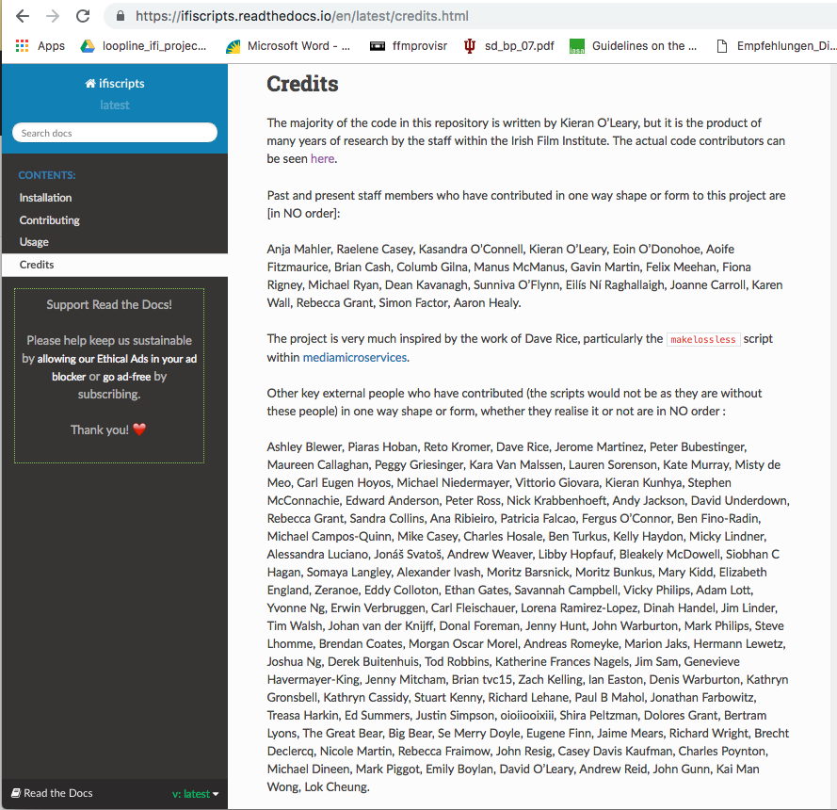

Slide 32
Integration into IFI
Not everyone needs to know how to code
Every IFI staff member involved in digital preservation activities must be proficient in the command line
Don’t worry - we provide a lot of training!
Encouragement to report issues and suggest improvements
Be open about work practises - perhaps some repetivive, monotonour, inaccurate work can be automated?
Encouragement to contribute code - minor fixes and documentation improvements do not require much coding knowledge
Encouragement to use tools to diagnose and fix issues for long term up-skilling

Slide 33
Different environments, different metadata
Sony M2000P Digibeta deck | OSX | AJA Kona 3 |Final Cut Pro 7
Sony DVW-510P Digibeta deck | Windows 7 | Aja Kona LHE+ | AJA Control Room
Sony UVW-1200P Betacam SP deck | Windows 7 |Aja Kona LHE+ | AJA Control Room
Sony J30 | El Capitan |Mac Pro| Blackmagic Ultrastudio 4K| Blackmagic Media Express.

Slide 34
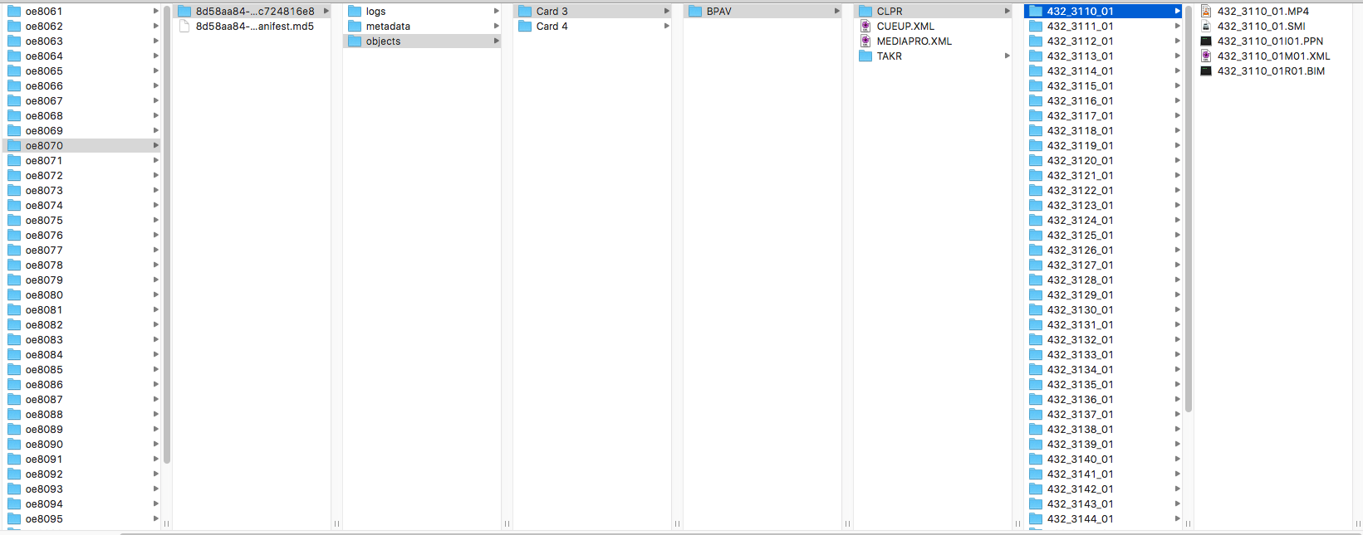

Slide 35
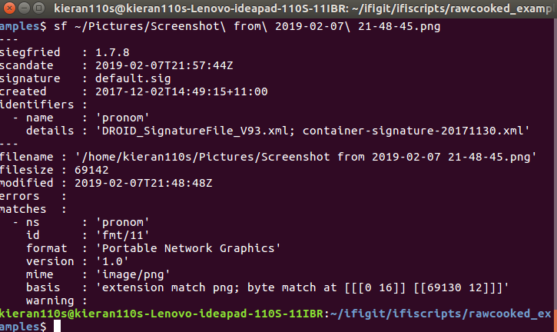
Format Identification via command line

Slide 36
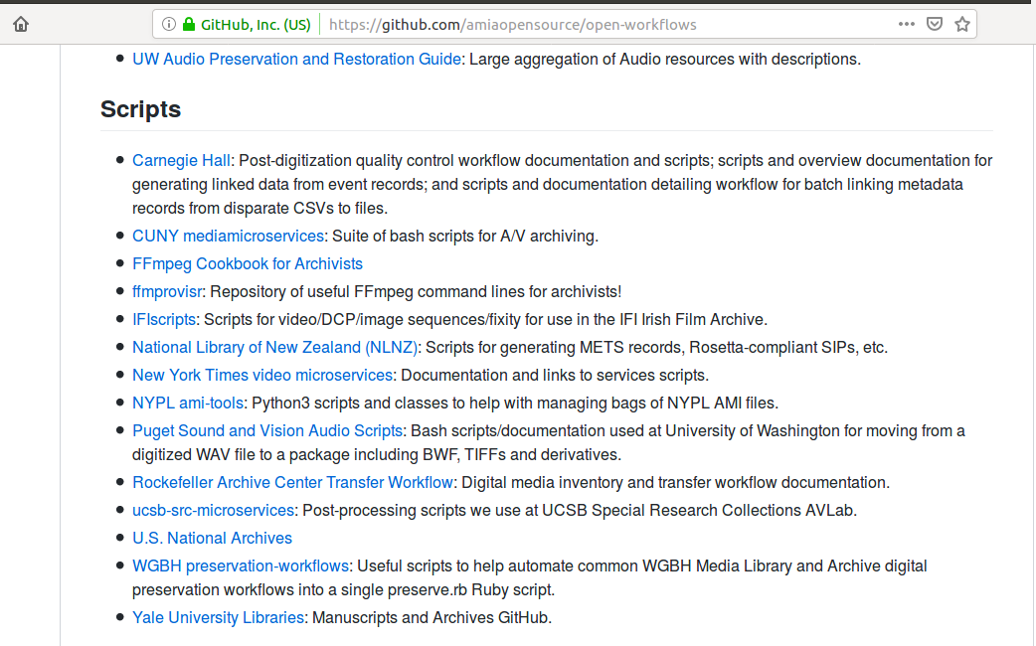

Slide 37
Impact
Winner of Digital Preservation Coalition award: The National Archives Award for Safeguarding the Digital Legacy
Used/altered by many archives in multiple continents.
Used by individuals, film festivals, artists and other unexpected users.
Inspired similar projects.
Led to IFI financially supporting some of the open source tools that we use.

Slide 38
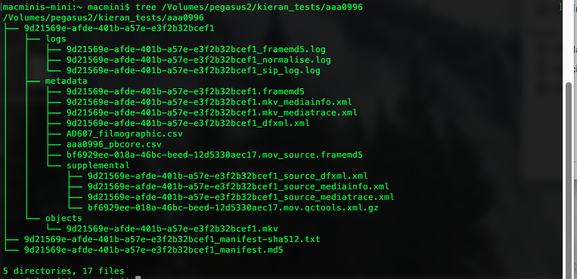

Slide 39
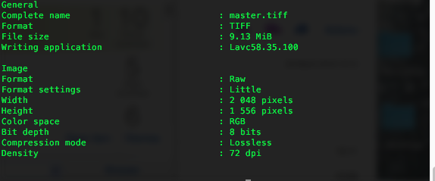
Source TIFF

Slide 40
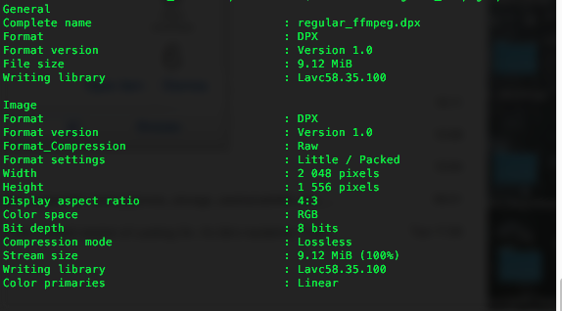
Incorrect metadata in normalisation!

Slide 41
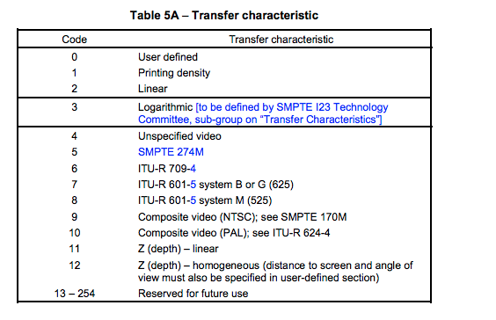
Studying/Altering the source code in FFmpeg
https://github.com/FFmpeg/FFmpeg/blob/master/libavcodec/dpxenc.c

Slide 42
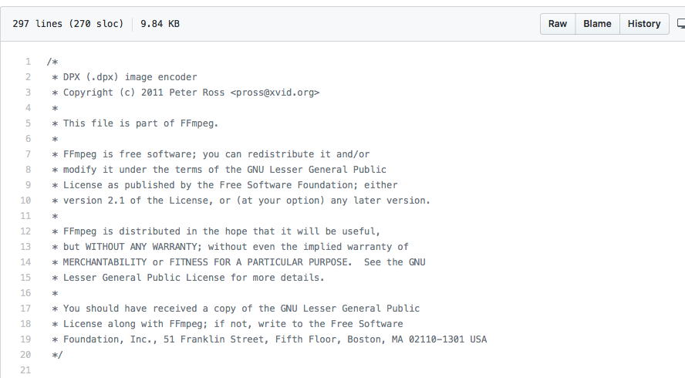

Slide 43
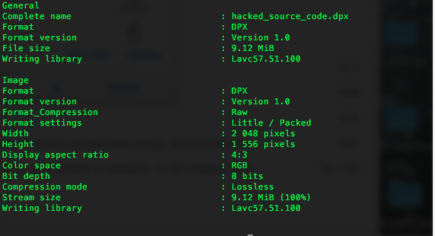
Result - No incorrect metadata!

Slide 44
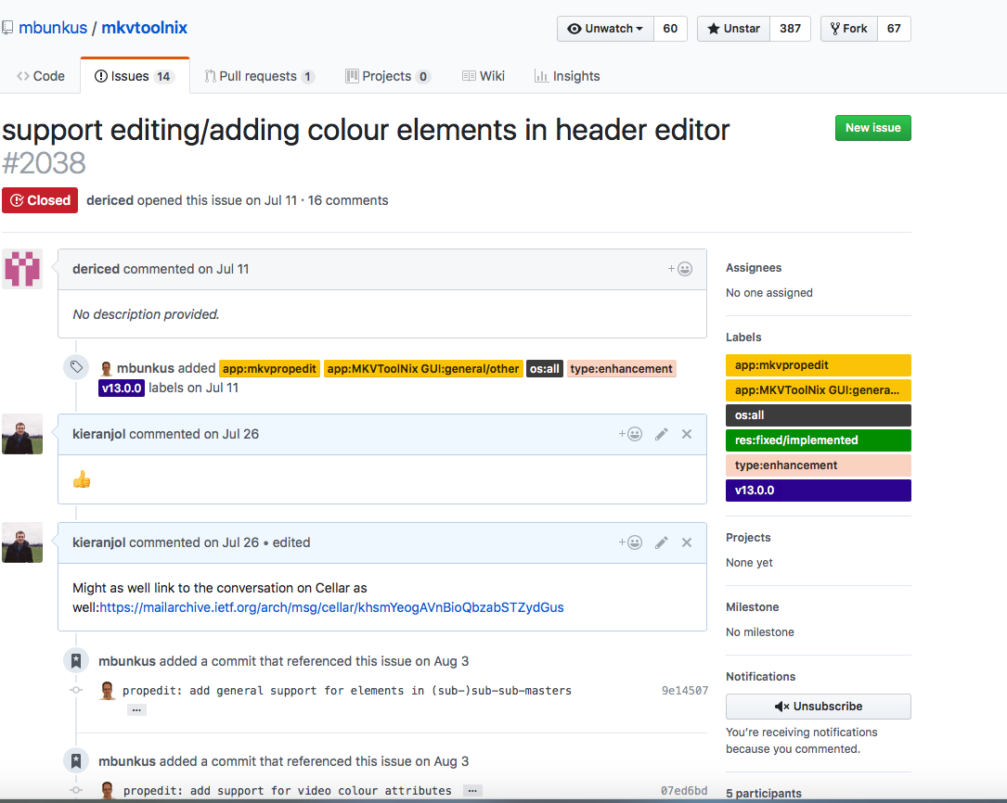
Raising issues!

Slide 45
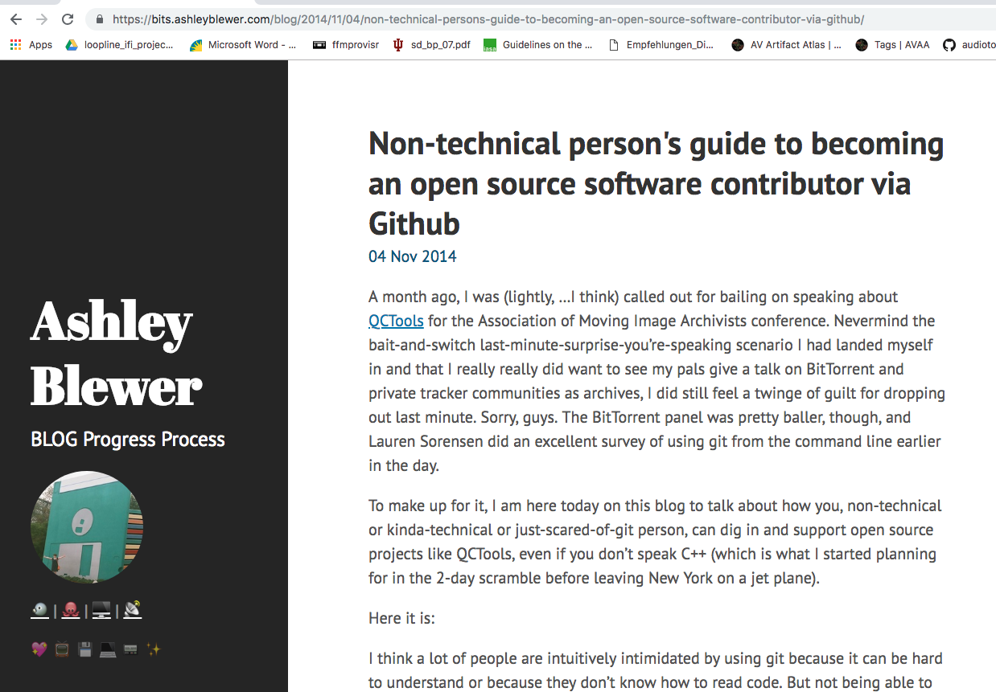
https://bits.ashleyblewer.com/blog/2014/11/04/non-technical-persons-guide-to-becoming-an-open-source-software-contributor-via-github/

Slide 46
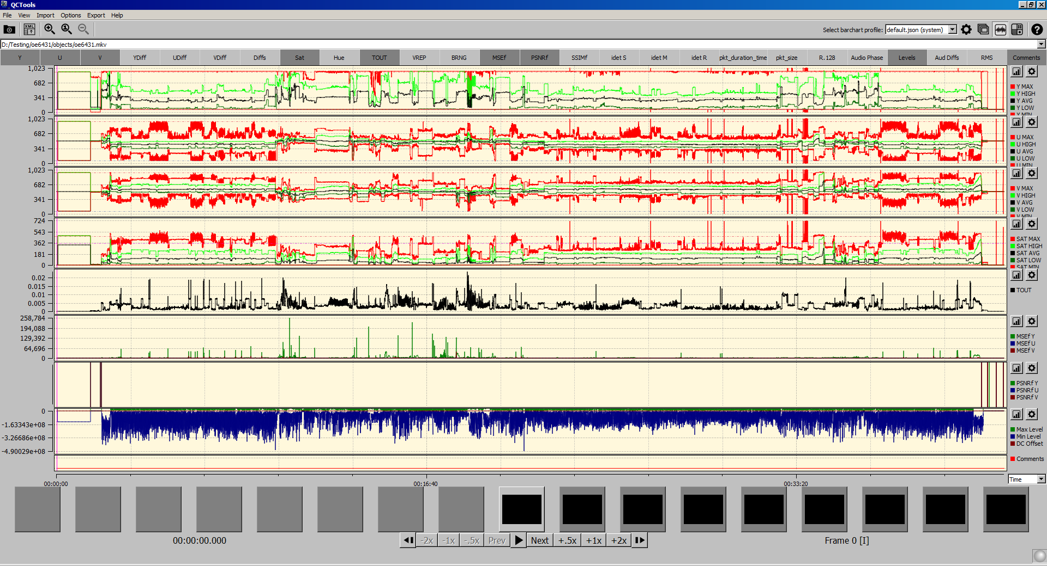

Slide 47
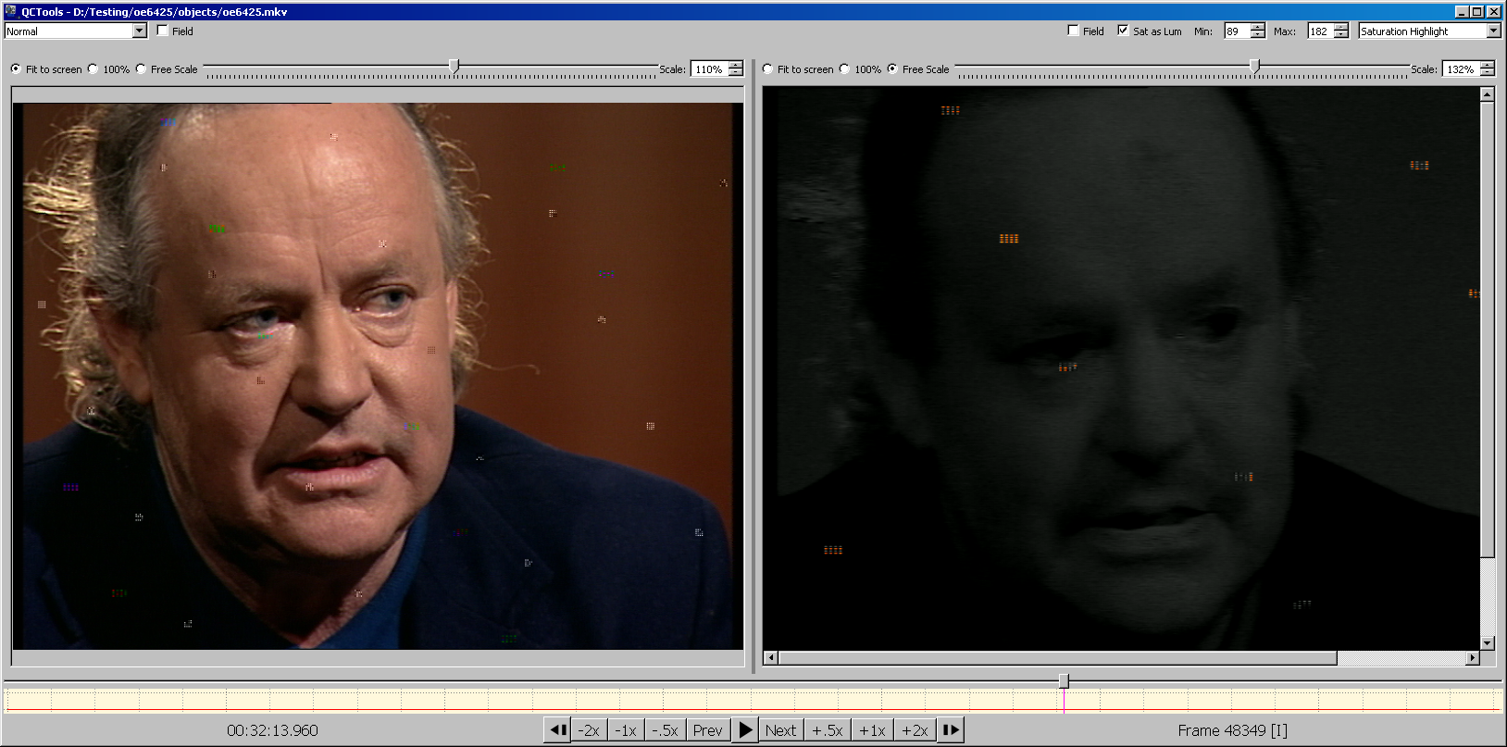

Slide 48
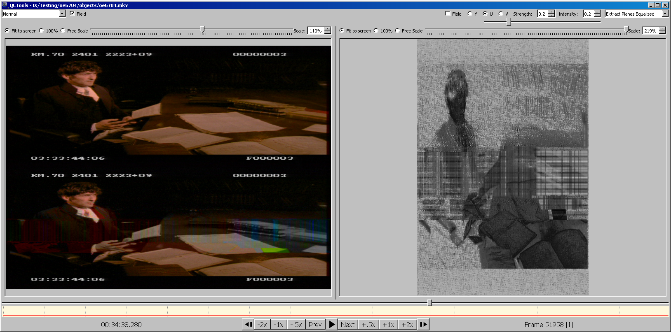

Slide 49
How to contribute to open source software
Financial contributions
Donation
Add features
Fix bugs
Report bugs via issue trackers - and look at contribution guidelines first!
Write/edit documentation
Promote open source tools via blogs/conferences
Test, Test, Test!

Slide 50
Some resources
COPTR - http://coptr.digipres.org/Main_Page
Open workflows - https://github.com/amiaopensource/open-workflows
CRALS - https://dd388.github.io/crals/
Ashley Blewer - https://bits.ashleyblewer.com/blog/2014/11/04/non-technical-persons-guide-to-becoming-an-open-source-software-contributor-via-github/
IFIscripts - https://ifiscripts.readthedocs.io/en/latest/index.html
My blog: https://kieranjol.wordpress.com/
Dave Rice - Framemd5 blog: http://dericed.com/papers/reconsidering-the-checksum-for-audiovisual-preservation/

