Slide 1
Using Excel
for
creating and improving
archive catalogues
Why and How
Gillian Sheldrick
Excel for Archivists
SheldrickG@Gmail.com

Slide 2
Welcome
and
Background
Gillian Sheldrick
Excel for Archivists
SheldrickG@Gmail.com

Slide 3
Overview
SESSION 1: Discussion and Demonstration
Why use Excel: benefits and case study
How to use Excel: key techniques
Excel pitfalls
SESSION 2: Excel Questions and Answers

Slide 4
Why Use Excel?
Benefits
Case study

Slide 5
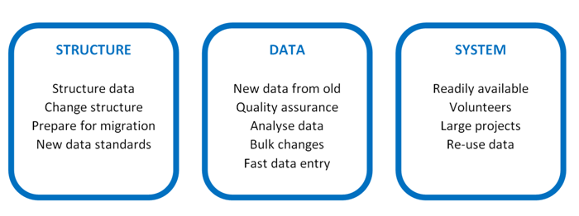
WHY USE EXCEL?

Slide 6
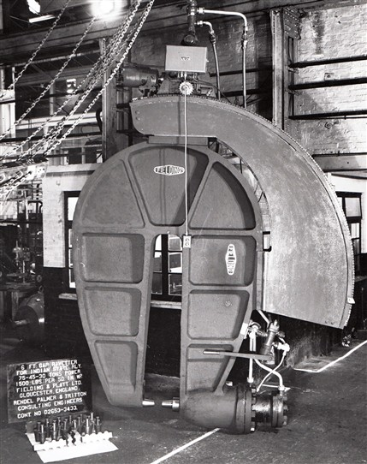
Fielding
and
Platt
Project
Gloucestershire Archives

Slide 7


Slide 8
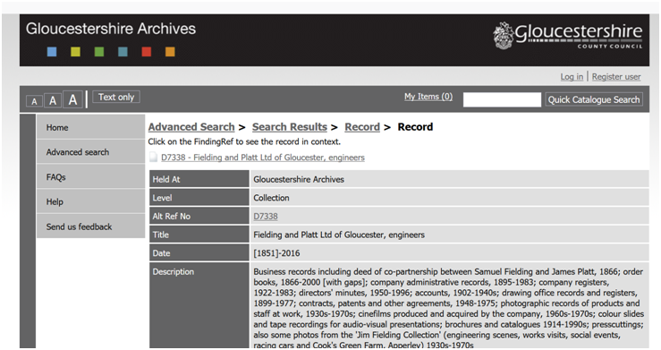

Slide 9
HOW TO USE EXCEL
Some Techniques

Slide 10
Is it Excel?
Many excellent (free) alternatives
Applicability: Microsoft Excel (2007 on)

Slide 11
Filtering Data

Slide 12
Filtering Data
Filtering Data: How
Enable filtering (Home ribbon>Editing menu> Sort and filter>Filter)
Activate filter: click arrow and select terms
Clear all filters (Home ribbon>Editing menu> Sort and filter>Clear)
Remove all filters (Home ribbon>Editing menu> Sort and filter>Filter)
Filtering Data: Some Uses
Edit or copy a sub-set of data
View selection from large data set
Data checking
Filtering Data: To Note
Can filter on multiple columns
Data is not altered, moved or deleted

Slide 13
Sorting Data

Slide 14
Sorting Data
Sorting Data: How
Select data for sorting
Home ribbon>Editing menu> Sort and filter>Custom sort
‘My data has headers’ (on/off)
Select ‘sort by’
For additional sort criteria ‘Add level’
Sorting Data: Some Uses
Changing the order of rows
In the example, applying an initial structure to a list created in box order, by sorting by place, date and classification
Sorting Data: To Note
The order of rows is altered
Useful to number the rows before starting, to ensure you can re-sort to original order
Beware sorting on subset of data (eg a column): risk of corrupting the data.

Slide 15
Subdividing Columns

Slide 16
Subdividing Columns
Subdividing Columns: How
Move selected column to the right (for convenience)
Select column
Data Ribbon>Data Tools>Text to Columns
Delimited > Next
Choose delimiter and view preview > Finish [or next]
Subdividing Columns: Some Uses
Make data easier to view
Prepare data for migration by matching required column layout
Enable sorting on terms within a column
Subdividing Columns: To Note
Data must be structured in some way
Default is to overwrite existing data, but can choose where to put it

Slide 17
Functions and Formulas

Slide 18
Functions and Formulas
Formulas: How
Enter Equals sign ( = ); this always indicates a formula
Select function from Formulas > Function Library
Copy completed formula to adjacent cells
View formula in formula bar
Formulas: Some Uses
Transform data (in almost any way you can think of)
Understand data (eg by counting terms, or identifying duplicates)
Formulas: To Note
‘Formula’ is the sequence of commands introduced by the equals sign
‘Functions’ are the special words used in a formula to perform a specific task
Formulas can act on other formulas
Instead of very complex formulas, combine formulas in a sequence; each step can then be checked separately

Slide 19
Autofill

Slide 20
Autofill
Autofill: How
Select cell
Click on square autofill handle
Drag down
To choose exact copy or list use autofill options menu
Autofill: Some Uses
Quickly insert standard data into multiple cells
Insert a formula into multiple cells
Insert sequential lists into multiple cells
Autofill: To Note
Built in sequences: numbers, months, days of the week

Slide 21
HOW TO USE EXCEL
Some Pitfalls

Slide 22
Data Types
[“number format”]

Slide 23
Data Types [“number format”]
Data Types: How
Set the type before entering data: Home Ribbon > Number menu
Data Types: To Note
Data types are persistent and hard to get rid of once associated with the data
For existing data – especially if copied from elsewhere - what the number menu displays may not be accurate
Data Type – “text” is often ‘safest’
Data Types: To Beware
Data Type = General: risk that Excel will determine what format to impose
Data Type = Number: rounds up or down; may not be what is needed
Data Type = Date: stored as days since 1900; has no effect with earlier dates

Slide 24
Pasting Data from Word

Slide 25
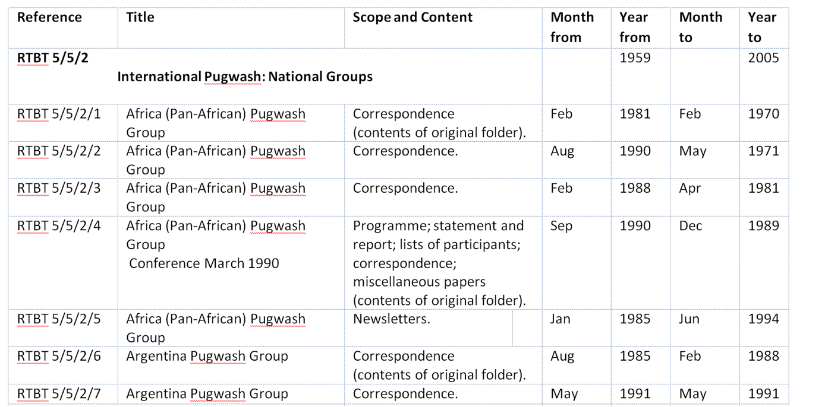

Slide 26
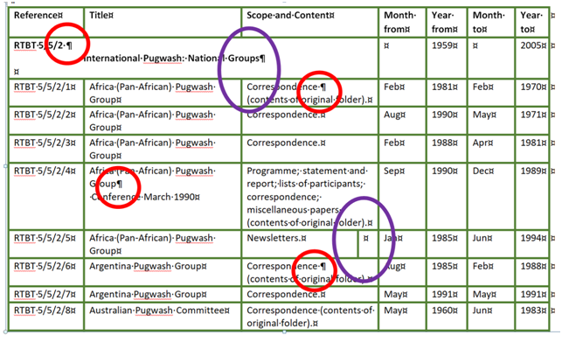

Slide 27
Pasting data from Word
Pasting Data From Word: How
Normally best to ‘paste as text’
Pasting Data From Word: To Note
Formats and Data Types will normally be copied from Word to Excel
Pasting Data From Word: To Beware
Before copying, check the Word document to ensure:
No merged cells
No additional columns
No new paragraphs/lines within cells

Slide 28
Session 1 Round-up
Why use Excel: benefits and case study
How to use Excel: key techniques
Excel pitfalls
SESSION 2: Your Excel Questions

Slide 29
Session 2
Your Excel Questions

Slide 30
Your Questions
Why can’t I find my data?
Migrating from Excel into Calm
Migrating from Excel into Adlib

Slide 31
Why can’t I find my data?

Slide 32
Why can’t I find my data?
If Data is obscured:
Widen column / Wrap/ unwrap text / Enlarge formula bar
‘Find’ does not find the data
Ensure you are searching ALL the data (not just selected cells)
Check the ‘More’ options (case sensitive; matching entire cell contents)
Use wildcards * and ?
Space is normally a character
Try the find next / find all options

Slide 33
Migrating from Excel
Adlib and Calm
Prepare your data
Ensure the correct data structure
Understand your system
Consult system manual
Test the migration

Slide 34
Migrating from Excel into Adlib
Use CSV format
Adlib designer
Beware: Designer can delete data permanently
Adlib Designer Help 7.2.pdf
(starting on page 510)
http://www.adlibsoft.com/support/manuals/maintenance-guides/designer-help-72

Slide 35
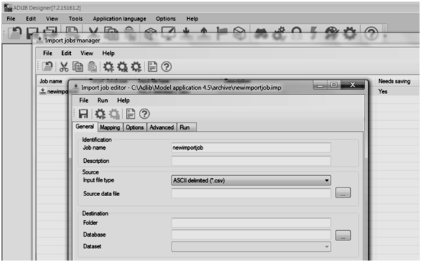
Migrating from Excel into Adlib

Slide 36
Migrating from Excel into Calm
Consult the Calm Manual
http://www.dswebhosting.info/alm/main_menu/importing_and_exporting/importing_records.htm
Step by step instructions for mailmerge via Word:
http://www.dswebhosting.info/Documents/User%20Guides/Calm%20ALM%20&%20RM%20v10%20Importing%20from%20Spreadsheets.pdf
Or use .CSV format

Slide 37
Migrating from Excel into Calm
Following Mailmerge into InDScribe Natural format (one record)
:Component
-Level
Item
-RefNo
D275A/1/1
-Title
Stroud Cooperative Society Rules
-Extent
1 document
-Date Earliest
1899
-Date Latest
1975

Slide 38
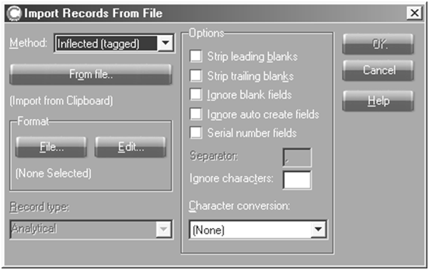
Migrating from Excel into Calm
Calm Import records from file dialogue box

Slide 39
Taking it further:
Excel for Archivists Workshops
What’s included
Step by step notes
Practical exercises
Real life examples
Small groups

Slide 40
Taking it further:
Excel for Archivists Workshops
What’s covered
Level 1: Key techniques including simple formulas
Level 2: Data improvement and data migration

Slide 41
Taking it further:
Excel for Archivists Workshops
Find out more
Contact me at
SheldrickG@Gmail.com

