Slide 1
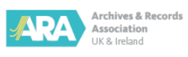
The ARA Professional Development Programme
Chris Sheridan Head of Professional Standards and Development

Slide 2
Continuing professional development (CPD)
ARA competency framework
Professional development programme

Slide 3
What is CPD?
An ongoing process of learning through experience and reflection
Any activity has the potential to provide you with CPD as long as there is a learning outcome

Slide 4
How will CPD help me?
Give you a competitive edge
Help you advance your career
Be the best you can be

Slide 5
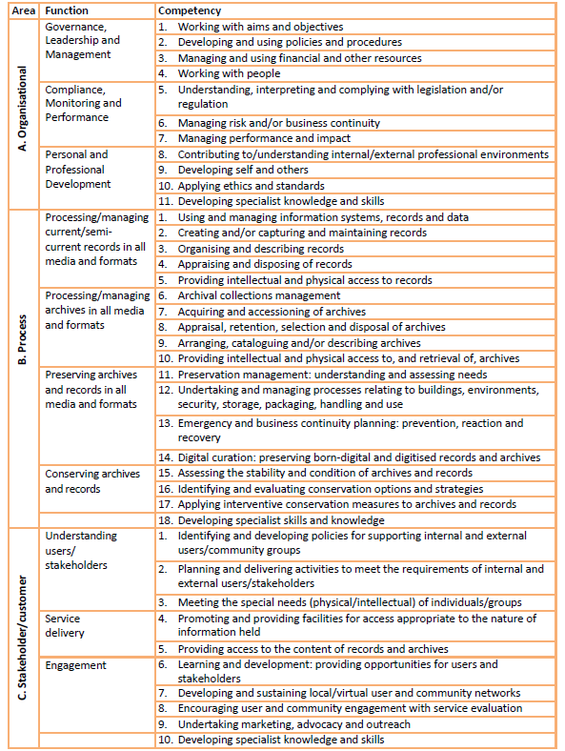
Competency framework
National standards in record keeping for the UK and Ireland.
Key competencies for all those working and volunteering within the record-keeping sector
Organisational: about your role in the workplace
Process: about the activities that your role involves
Stakeholder/customer: about how you interact with others

Slide 6
Each competency has five experience levels:
novice (level 1)
beginner (level 2)
competent (level 3)
proficient (level 4)
expert (level 5)

Slide 7
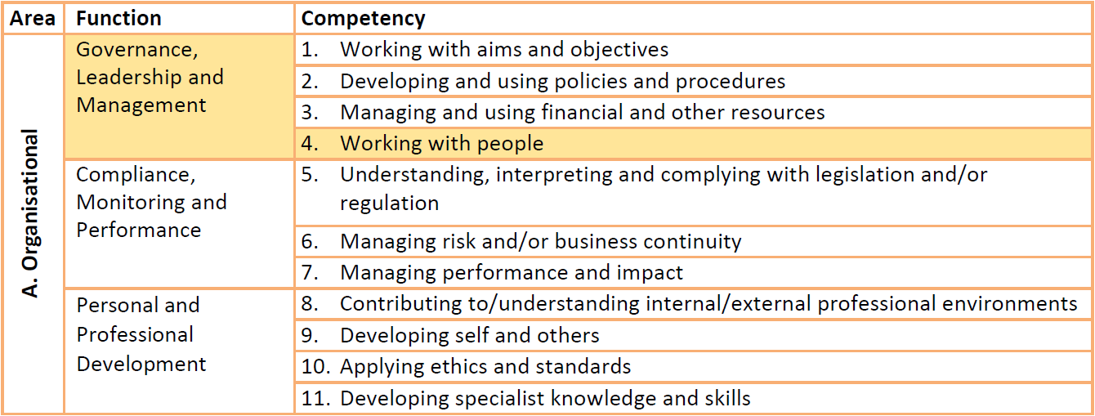

Slide 8
working with people

Slide 9
Level 1 (novice): Identifies and can describe roles and responsibilities of those in immediate working environment; contributes actively and inclusively to team work
Level 2 (beginner): Operates effectively as team member; uses team dynamics to foster good team working and inclusivity; interacts well with volunteers and internal/external groups sharing expertise with others; acquires training where required
Level 3 (competent): Develops and supervises own and others’ work plans and skills; monitors individual/team performances ensuring appropriate training for self/others; contributes proactively to workplace/community
Level 4 (proficient): Formulates workplace policies; recruits, develops and manages people; oversees conflict resolution; establishes team(s) with complementary strengths and skills
Level 5 (expert): Leads and sets the standard in the development of staff; initiates workforce policies; manages and resolves conflict in complex situations

Slide 10
Professional Development Programme
A competency based process through which members can qualify as a Foundation or Registered Member, or Fellow of the ARA

Slide 11
The benefits . . .
Gain national professional recognition with Foundation (FMARA), Registered (RMARA) and Fellow (FARA) levels of membership
Increase your level of confidence and influence in the workplace
Provides a clear path to developing your career, your employability and earning potential – linked to latest ARA salary recommendations
Demonstrates you meet industry recognised standards of knowledge and competency
Become a reflective and ethical practitioner
Be part of a professional community at the forefront of archives, archive conservation and records management

Slide 12
Foundation (FMARA)
For those relatively new to the profession, existing professionals who do not yet have the level of experience required for Registered membership, apprentices and volunteers
We recommend candidates have a minimum of 12 months experience
To qualify: Submit 6 competencies demonstrating experience levels 1 - 2. At least 1 competency from each of the 3 competency areas

Slide 13
Registered (RMARA)
The established level of excellence for the profession
We recommend candidates with an ARA accredited qualification gain a minimum of three years’ post-graduation work experience
To qualify: Submit 8 competencies demonstrating experience levels 2 - 3. At least 2 competencies from each of the 3 competency areas

Slide 14
Fellow (FARA)
The highest level of professional recognition
We recommend candidates hold a minimum of nine years work experience following their qualification as a Registered Member of the ARA. They must have completed at least one CPD Review cycle
To qualify: 6 competencies demonstrating experience levels 4-5, a contribution to the profession statement and a professional development statement

Slide 15
CPD Review
Foundation, Registered and Fellow members undertake a CPD review every 5 years
Members identify four development objectives, explain how they met the objectives, and reflect on the outcome
The Review ensures that Foundation and Registered Members, and Fellows of the ARA, continue their professional development

Slide 16
Professional development programme
Self
Assessment
Benchmark your experience against the ARA competency framework
Find a
mentor
Someone with experience & knowledge to give direction to your learning
Enrol on the programme
Enrol online and work with your mentor
Prepare your application
Develop the competency forms in your application to the required level
Apply
Submit your application online for assessment
Maintain your professional status
CPD Review, events, information & career support
archives.org @ARACPD
Notes:
All professionals experience change and the archives and records sector is no different. External influences such as legislative change, digitisation, emerging best practice and new workforce development strategies are just some examples of why this profession cannot stand still.
We all need to continue to develop knowledge, skills and competencies to ensure that whatever role we are in and in whichever capacity we are working, we are equipped to respond positively to change. CPD is the process through which we do this.

Slide 17

Contact
Chris Sheridan
Email: chris.sheridan@archives.org.uk
Phone 07377 940696
https://archivesandrecords.smapply.io/

